Slide 1
Design Challenges/issues of Distributed Systems
Heterogeneity
Distribution Transparency
Flexibility/ Openness
Reliability/Fault Tolerance
Scalability
Concurrency
Performance

Slide 2
Challenges
Heterogeneity
  Heterogeneous components must be able to interoperate across different platforms.
Distribution transparency
  Distribution should be hidden from the user as much as possible
Fault tolerance
  Failure of a component (partial failure) should not result in failure of the whole system
Scalability
  System should work efficiently with an increasing number of users
  System performance should increase with inclusion of additional resources
Notes:
Heterogeneity: Big/Little Endian, other platform differences have mostly been solved thanks to new DS protocols, TCP/IP, WS, Corba etc
Dist. Transparancy: We can utilise services like DNS and Hyperlinks to mask the fact that many machines are involved in DS.
Fault tolerance: Can be achieved via careful programming and assumptions, replicated (eg fall-over) servers for backup.
Scalability: Smart load distribution / balancing, good scalable design.

Slide 3
Challenges
Concurrency
  Shared access to resources must be possible
  Openness
  Interfaces should be publicly available to ease inclusion of new components
  Performance
  Performance of DS must be at least as good as a centralized system
Notes:
Concurrency: Access to a shared resource must be synchronised so that data remains consistent (I.e. via semaphores/locks). Most modern programming languages (like Java) do the hard work for us, so no excuses!!
Openness: Open standards, open API’s, open message protocols
Security: Good secure design, combining encryption, authentication and access control.

Slide 4

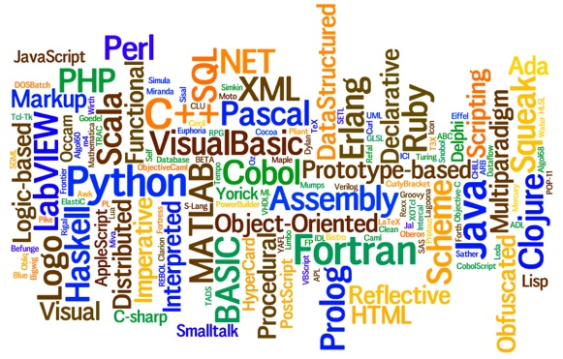
Heterogeneity
Heterogeneous components must be able to interoperate across different:
  Operating systems
  Hardware architectures
  Communication architectures
  Programming languages
  Software interfaces
  Security measures
  Information representation
Notes:
Different OS: Windows, MacOS, Linux, BSD
Hardware: Intel, PowerPC, Sparc, ARM
Comm. Arch’s:
Programming Languages: C/C++, Java, Perl, Python, Ruby, etc
Software interfaces: Common interfaces are needed (RPC, WS)
Security measures: Need to talk same language (3DES, Blowfish, etc)

Slide 5
Distribution transparency
Transparency
Description
Access
Hide differences in data representation and how a resource is accessed.
Location
Hide where a resource is located
Migration
Hide that a resource may move to another location
Relocation
Hide that a resource may be moved to another location while relocation in use
Replication
Hide that a resource may be shared by several competitive replication users
Concurrency
Hide that a resource may be shared by several competitive concurrency users
Failure
Hide the failure and recovery of a resource
Persistence
Hide whether a (software) resource Persistence is in memory or on disk

Slide 6
Flexibility / Openness
The design of distributed system should be flexible
1. Ease of modification :
It should be easy to incorporate changes in the system with minimum interruption caused to the users.
2. Ease of enhancement :
It should be easy to add new services to the system.

Slide 7
Fault Tolerance / Reliability
The idea is that if a machine goes down, some other machine takes over the job.
Commonly used methods for dealing with reliability are
Fault tolerance
It is the ability of a system to continue functioning in the event of partial system failure.
2. Fault avoidance
It deals with designing the components of the system in such a way that the occurrence of faults is minimized.
3. Fault detection and recovery
It is ability of the system to determine the occurrence of a failure and then to correct the system to a state acceptable to continued operation.

Slide 8
Scalability
Scalability refers to the capability of a system to adapt to increased service load.
Some guiding principles for designing scalable distributed systems are as follows:
Avoid central entities
A single file server or single database server
2. Avoid centralized algorithms
Routing based on complete information
3. Perform most operations on client
Caching is a frequently used technique for the realization of this principle.

Slide 9
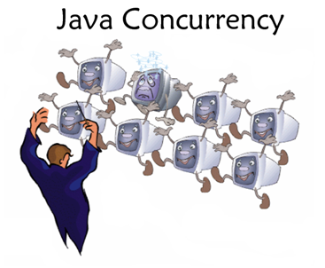
Concurrency
Provide and manage concurrent access to shared resources:
  Fair scheduling
  Preserve dependencies (e.g. distributed transactions)
  Avoid deadlocks
Notes:
Fair scheduling ensures everyone gets a turn on a popular resource
Dependencies occur for transactions. Eg. Buy a book with Credit Card, check that user has sufficient funds before finalising the transaction
Deadlocks can occur when two users hold a resource, and they are waiting for each other to release their respective resource.

Slide 10
Performance
If a distributed system is to be used, its performance must be at least as good as a centralized system.
To achieve this goal, various components of the distributed system be designed properly such as
Batch if possible
Batching often helps in improving performance greatly.
Cache whenever possible
Caching of data at clients’ sites frequently improves overall system performance
3. Minimize network traffic
System performance may also be improved by reducing inter node communication costs.

